Slide 1
Ehlers-Danlos Type III and Tenascin-X dependent Gastric Dysfunction
A known variant with haploinsufficiency, loss of tenascin-x production
Team Tenasin (alphabetical order): Jared Bennett, Biter Bilen, Chase Violet, Christian Dima Lituiev, Holly Deremo,
Julide Bilen (Yes, sisters), Kubilay Maki Ogawa, Mike D'Amour, Rena, Sarah D, Sree Vaddi, Steven Ganz.
Helping Us (thank you): Ben Busby, Cosmo, Pete, and John!

Slide 2
John - why we are all here!
Abdominal pain, vomiting, gastric reflux, constipation, impacted bowels
History of back disc slippage, dislocation and some disc desiccation
Failure to thrive, low muscle tone, fatigue, weakness, malnutrition
Hypermobility (double shoulder dislocation-pass through around legs)
All of the above are symptoms that would cause distress independently, but when combined come together in a grouping that has the potential to find a common linkage, which we seek to explain today.

Slide 3
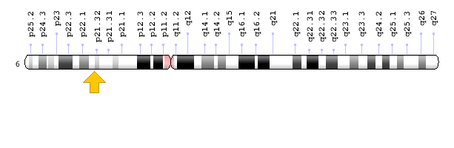
TNXB Gene & EDS type III
Analysis of whole genome sequencing using Qiagen Ingenuity Variant, revealed two known deleterious protein variants found within the exon segment of TNXB c.9044A>G, and c.9050A>G, causing Ehlers Danlos Type III, known as EDS Hypermobile type with an inferred loss of activity. This alteration has inferred loss of function based on being in a transcribed region of a haploinsufficient gene¹. The TNXB gene is also linked to Raynaud's (an autoimmune connective tissue condition), which the pt has a family history of.

Slide 4
EDS III
Ehlers-Danlos syndrome is a group of disorders that affect the connective tissues that support the skin, bones, blood vessels, and many other organs and tissues. The hypermobile type (EDS III) is characterized by an unusually large range of joint movement. The mutations that cause this form of the disorder occur in one copy of the TNXB gene in each cell. These mutations reduce the amount of functional tenascin-X that cells produce, which decreases the ability of tenascin-X to interact with collagens and elastic fibers. These changes weaken connective tissues in many parts of the body, which results in the signs and symptoms of the hypermobile type of Ehlers-Danlos syndrome.⁷

Slide 5
GI Involvement in EDS III
EDS III has been linked numerous times to GI dysmotility disorders, as well as other functional disorders like Gastric Reflux, Constipation, Nausea, Vomiting, Heartburn, abnormal gastric emptying, and abnormal colonic transit time ^{3,4}.
Severe abdominal and gastrointestinal issues are correlated with a difficult quality of life, increased upper abdominal pain severity was associated with increased depression and anxiety.⁶

Slide 6
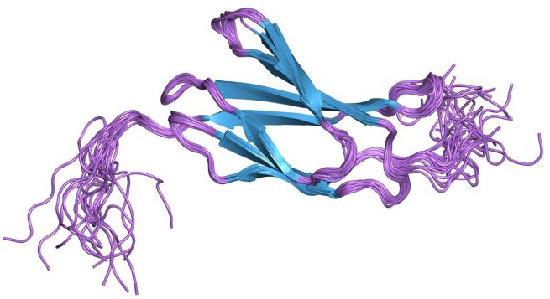
TNXB and Tenascin-X
TNXB is responsible for production of the extracellular-matrix protein tenascin-X (TNX). TN-X is the only member of tenascin evolutionary conserved extracellular matrix glycoproteins to exert a crucial architectural function as evidenced by a EDS III resulting from a loss-of-function of this glycoprotein in humans and mice. However, TN-X is more than an architectural protein, as it displays features of a matricellular protein by modulating cell adhesion.²

Slide 7
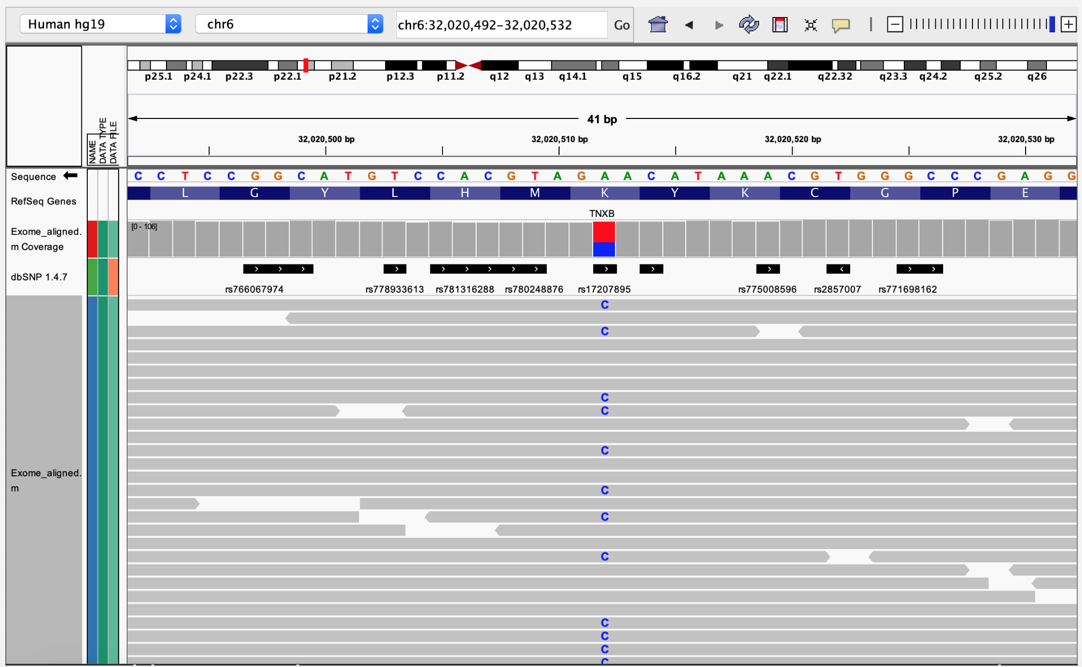
TNXB Variant is Heterozygous

Slide 8
TNXB and Tenascin-X contd.
In adult, TN-X mRNA is also observed at different levels in a variety of organs and tissues with a higher level in the digestive tract (pancreas, stomach, jejunum, ileum, and colon), and the highest expression in the heart, the skin, skeletal muscles, ligaments and tendons.²
Previously, it has been shown that TNX is required for neural control of the bowel by a specific subtype of mainly cholinergic enteric neurones and regulates sprouting and sensitivity of nociceptive sensory endings in mouse colon. These findings correlate with symptoms shown by TNX-deficient patients and mice⁵.

Slide 9
Tenascin-X, ECM, and the GI system
TNX was found to be present in calretinin-immunoreactive extrinsic nerve endings in mouse and human stomach. TNX deficient mice had increased vagal afferent responses to gastric distension that could be rescued with GABA-B receptor agonist. In TNXB-deficient patients, significantly greater symptoms of reflux, indigestion and abdominal pain were reported. A study published in only march of this year is the first to outline the role for TNX in gastric function.⁷
Further studies are required in TNX deficient patients to classify groupings of symptoms and to determine whether symptoms can be relieved using GABA-B agonists, like benzodiazepines, which the patient currently takes, and has found some relief using.

Slide 10
REFERENCES
Zweers, M. C., Bristow, J., Steijlen, P. M., Dean, W. B., Hamel, B. C., Otero, M., … Schalkwijk, J. (2003). Haploinsufficiency of TNXB is associated with hypermobility type of Ehlers-Danlos syndrome. American journal of human genetics, 73(1), 214–217. doi:10.1086/376564
Valcourt, U., Alcaraz, L. B., Exposito, J. Y., Lethias, C., & Bartholin, L. (). Tenascin-X: beyond the architectural function. Cell adhesion & migration, 9(1-2), 154–165. doi:10.4161/19336918.2014.994893
Botrus, G., Baker, O., Borrego, E., Ngamdu, K.S., Teleb, M., Gonzales Martinez, J.L., ... & McCallum, R. (2018). Spectrum of Gastrointestinal Manifestations in Joint Hypermobility Syndromes. The American journal of the medical sciences, 355(6), 573-80.
Nelson, A.D., Mouchli, M.A., Valentin, N., Deyle, D., Pichurin, P., Acosta, A., & Camilleri, M. (2015). Ehlers Danlos syndrome and gastrointestinal manifestations: a 20-year experience at Mayo Clinic. Neurogastroenterology and motility : the official journal of the European Gastrointestinal Motility Society, 27(11), 1657-66.
Aktar, R., Peiris, M., Fikree, A., Eaton, S., Kritas, S., Kentish, S.J., ... & Blackshaw, L.A. (2019). A novel role for the extracellular matrix glycoprotein-Tenascin-X in gastric function. The Journal of physiology, 597(6), 1503-15.
Parkman, H.P., Wilson, L.A., Hasler, W.L., McCallum, R.W., Sarosiek, I., Koch, K.L., ... & Pasricha, P.J.(in press). Abdominal Pain in Patients with Gastroparesis: Associations with Gastroparesis Symptoms, Etiology of Gastroparesis, Gastric Emptying, Somatization, and Quality of Life. Digestive diseases and sciences. doi:10.1007/s10620-019-05522-9
Demirdas, S., Dulfer, E., Robert, L., Kempers, M., van Beek, D., Micha, D., ... & Voermans, N.C. (2017). Recognizing the tenascin-X deficient type of Ehlers-Danlos syndrome: a cross-sectional study in 17 patients. Clinical genetics, 91(3), 411-25.

Slide 11
Tenasin-X, ECM, and the GI system
Explanations for GI manifestations are based on 2 major concepts³:
(1) Abnormal connective tissue in the gut wall might allow increased visceral compliance that promotes hollow organ distension, and
(2) changes in both pain thresholds and gut motility can contribute to various functional GI complaints.
MIGHT NOT NEED

